Slide 1



Intensive Course: Green Agenda for the Western Balkans
Climate Change : Global Impact and Mitigation Policies – Part 1
Jean Monnet Module
Funded by the European Union. Views and opinions expressed are however those of the author(s) only and do not necessarily reflect those of the European Union or EACEA. Neither the European Union nor the granting authority can be held responsible for them
Notes:
‹#›

Slide 2

Content:
1. Climate and poverty
2. Macroeconomic risk
3. Risk perception at individual level
Notes:
The first part of the lecture ëill offer an overvieë of the products offered for Disaster Risk management in the Insurance Market and ëill focus on the challenges of insurability in cases of disasters. Later, the folloëing sections ëill deal more in detail ëith capital markets instruments such as Cat Bonds
‹#›

Slide 3
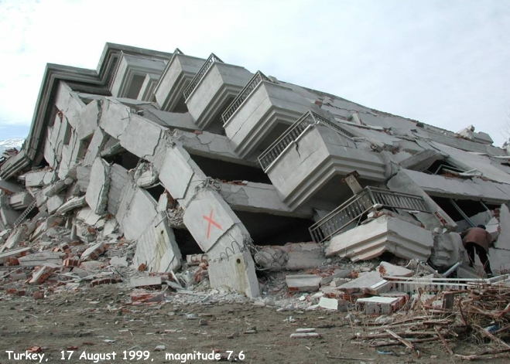
Collapse during Turkey earthquake, 1999

Slide 4
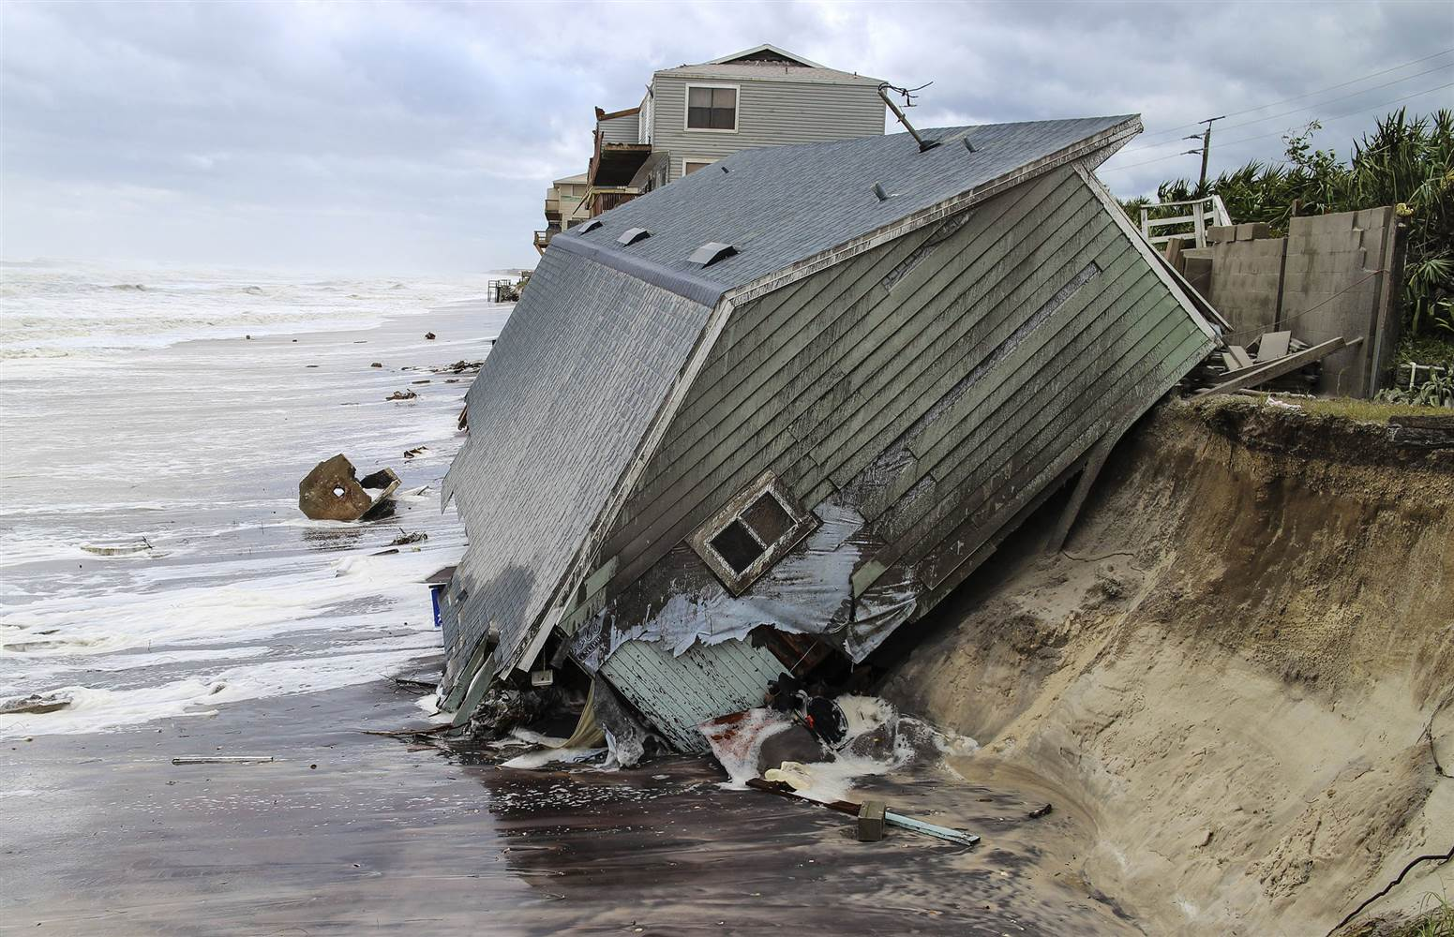
A house slides into the Atlantic Ocean in the aftermath of Hurricane Irma, 2017

Slide 5
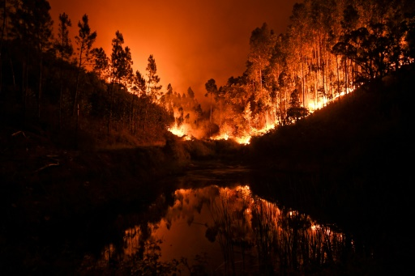
Forest fires in Portugal, 2017

Slide 6
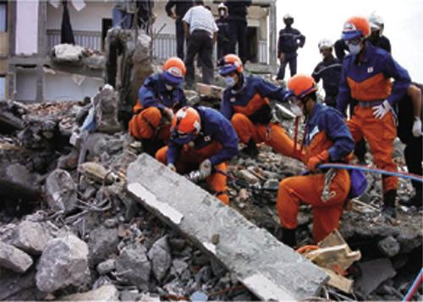
Search and rescue operations by the Japan Disaster Relief Rescue Team in 2003 after Algeria Earthquake

Slide 7
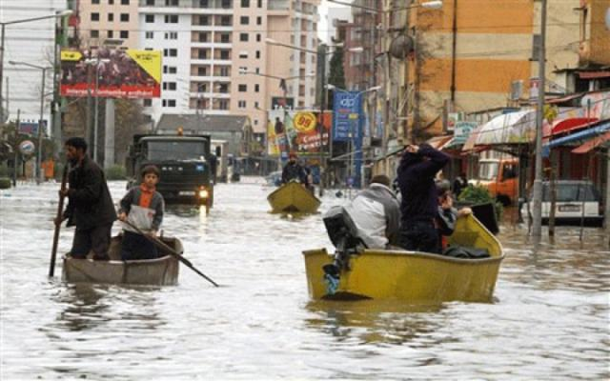
People evacuate using boats in the middle of the city Shkodra flooding, Albania, 2010

Slide 8
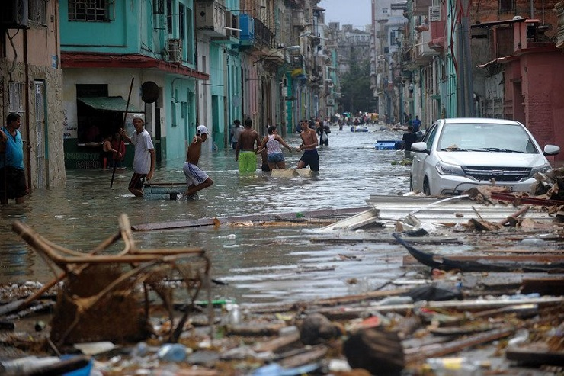
Image from Barbados, Caribbean Islands

Slide 9
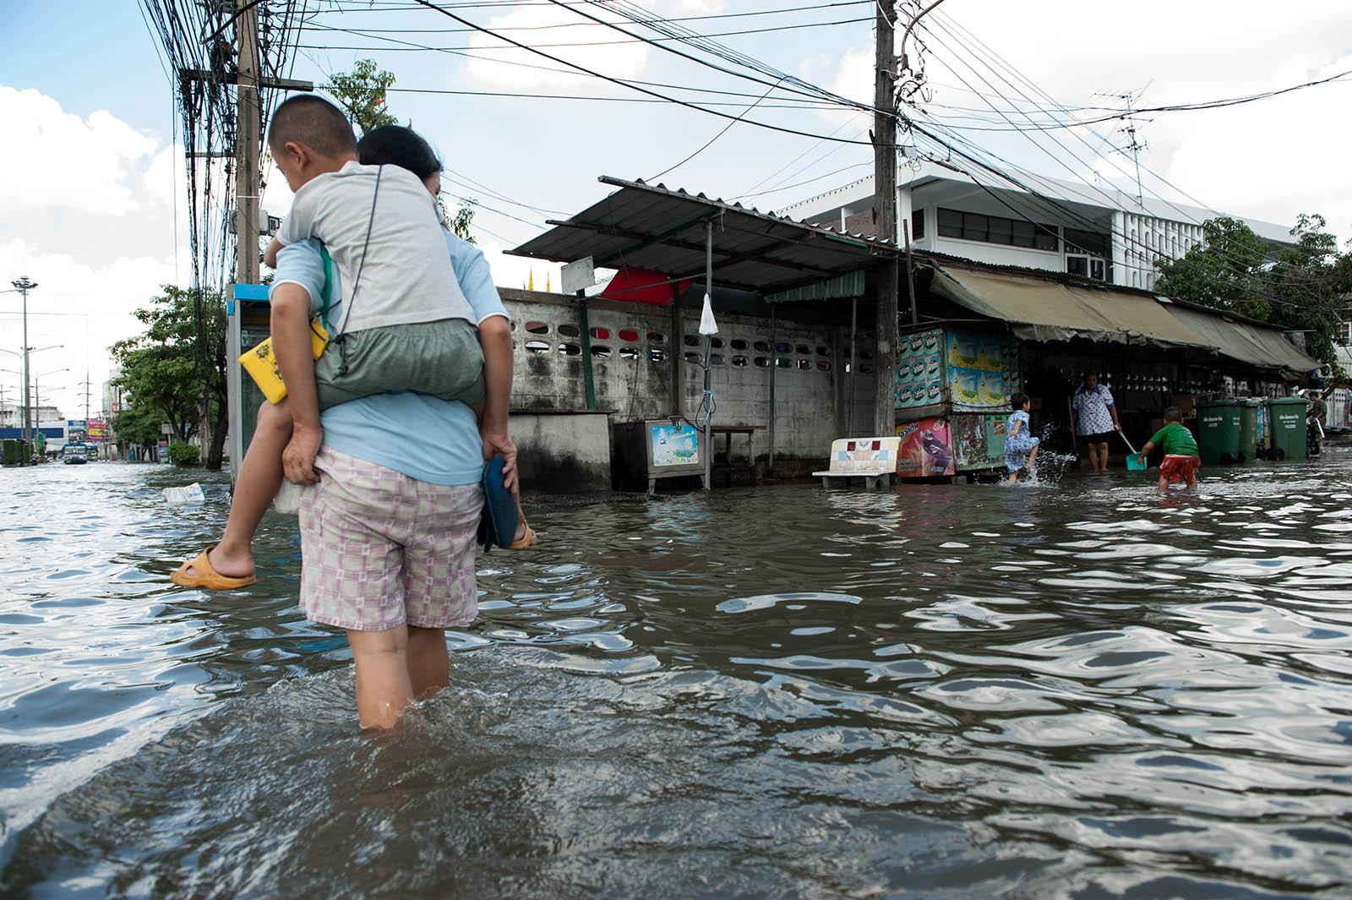

Slide 10
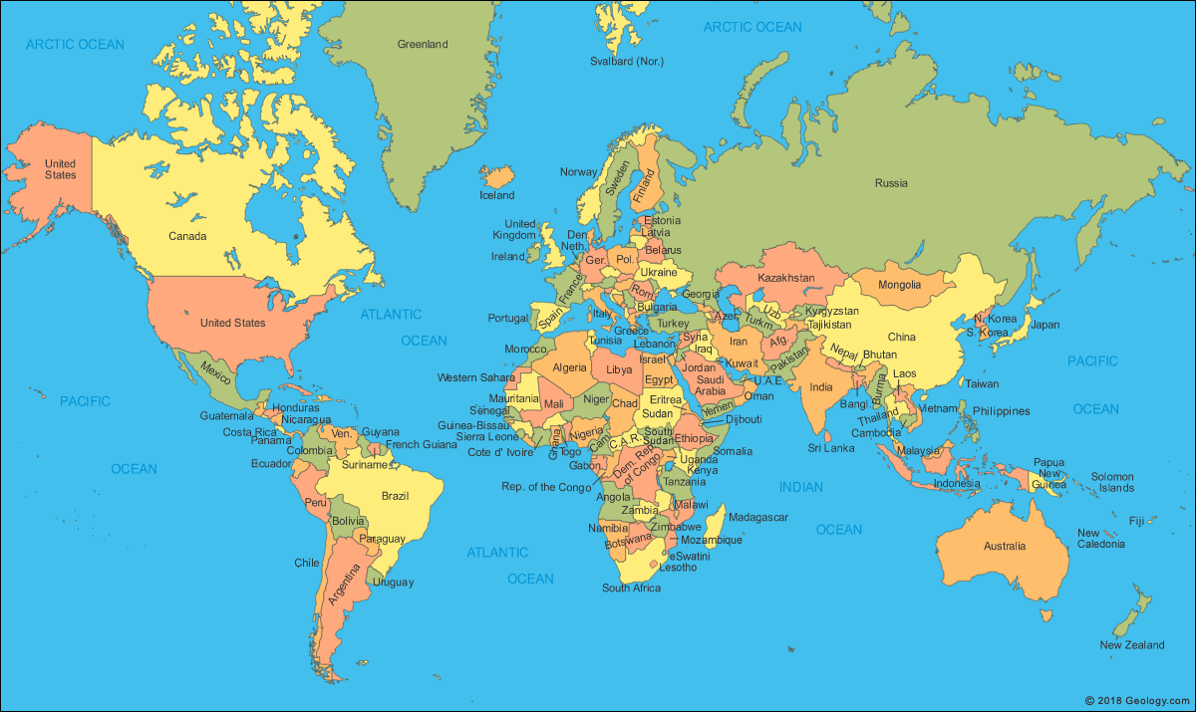

Slide 11
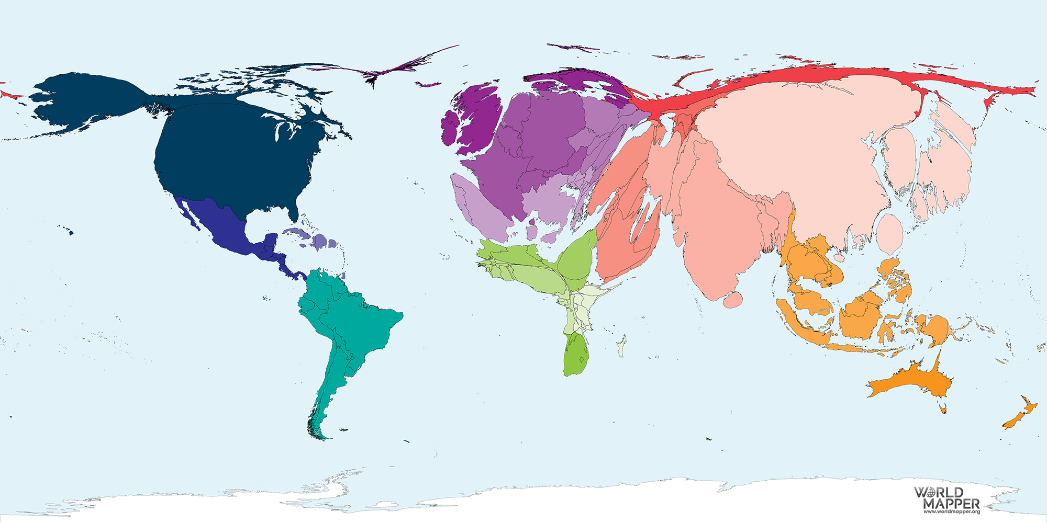

Slide 12
World map based on GDP

Slide 13
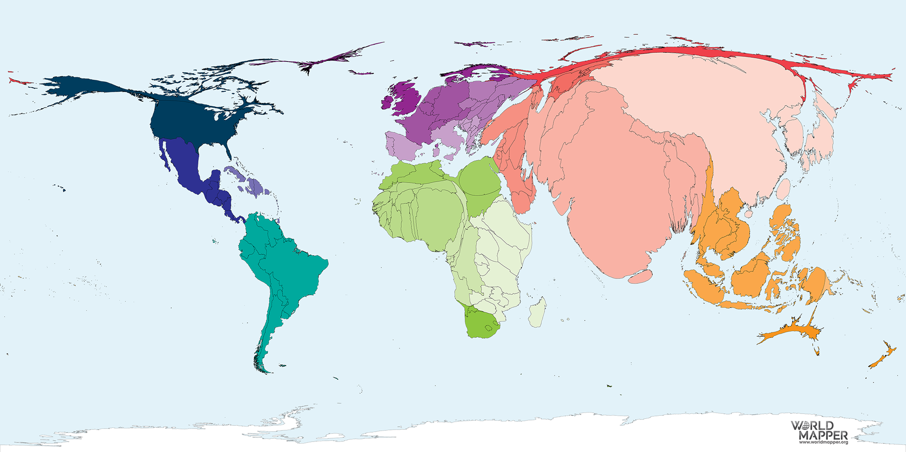

Slide 14
World map based on total population

Slide 15
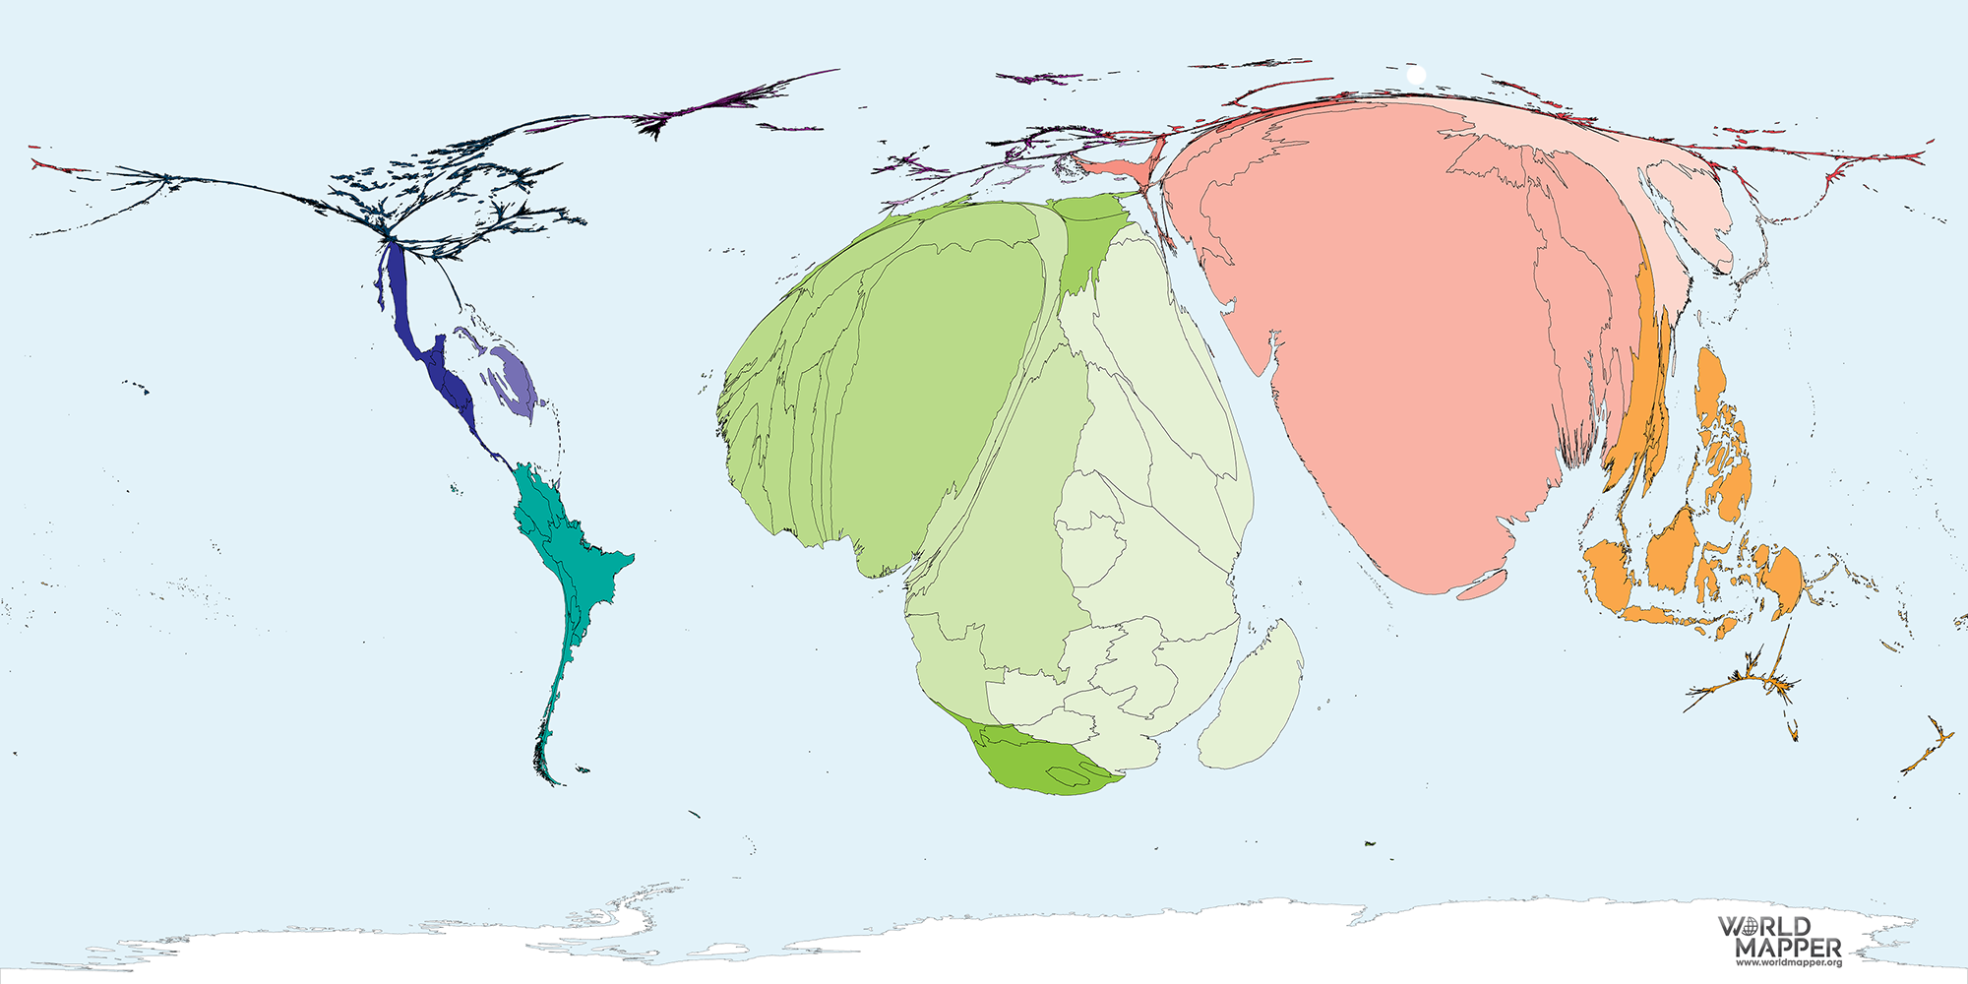

Slide 16
World map based on inequality, absolute poverty

Slide 17
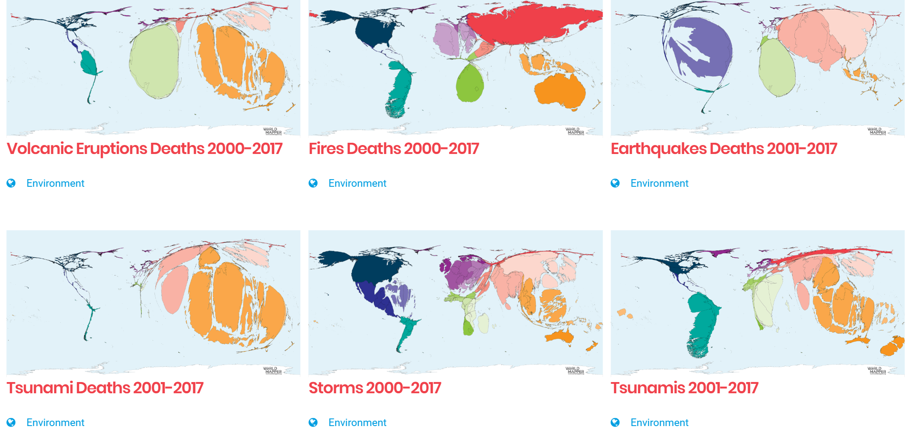
Maps and disasters

Slide 18
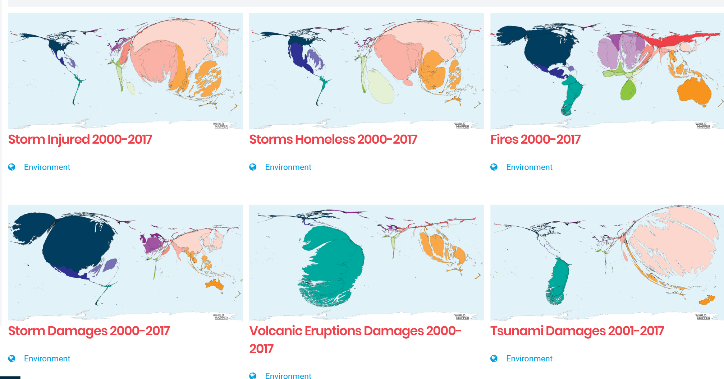
Maps and disasters

Slide 19
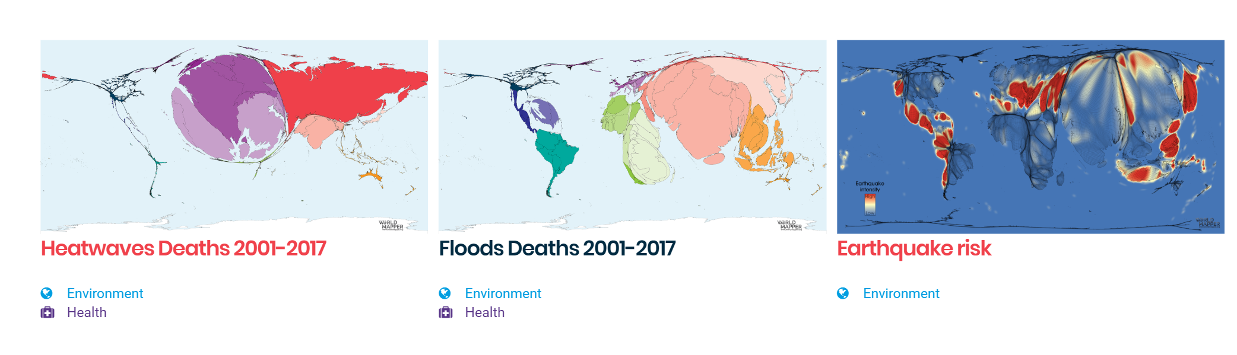
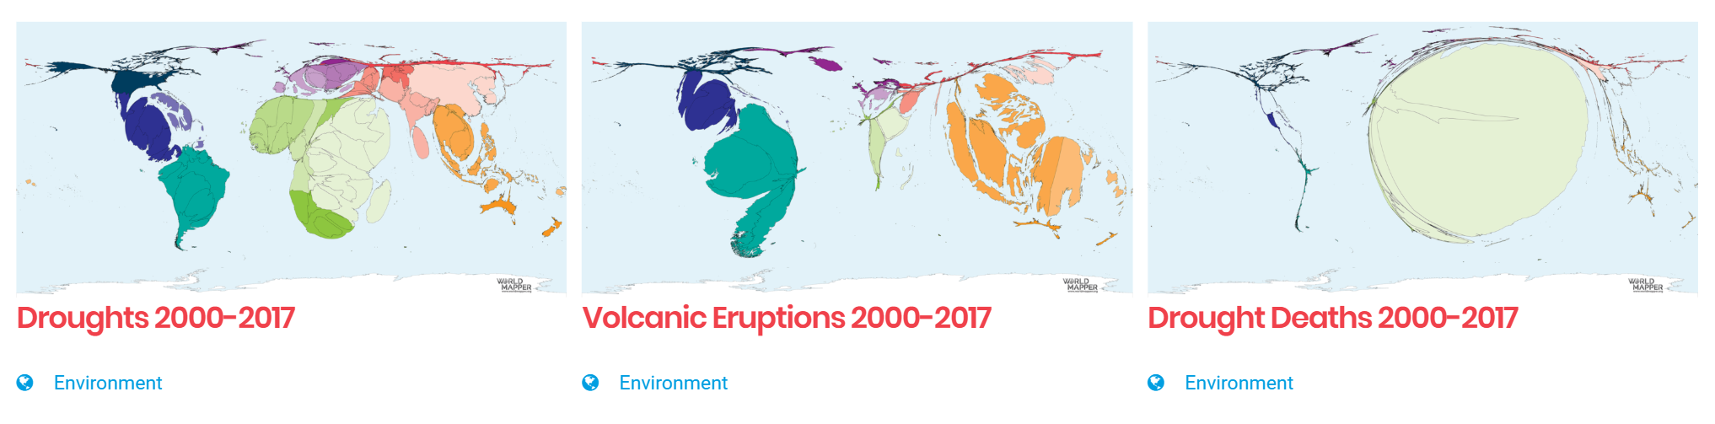
Maps and disasters

Slide 20
|First Part
Disasters and development

Slide 21
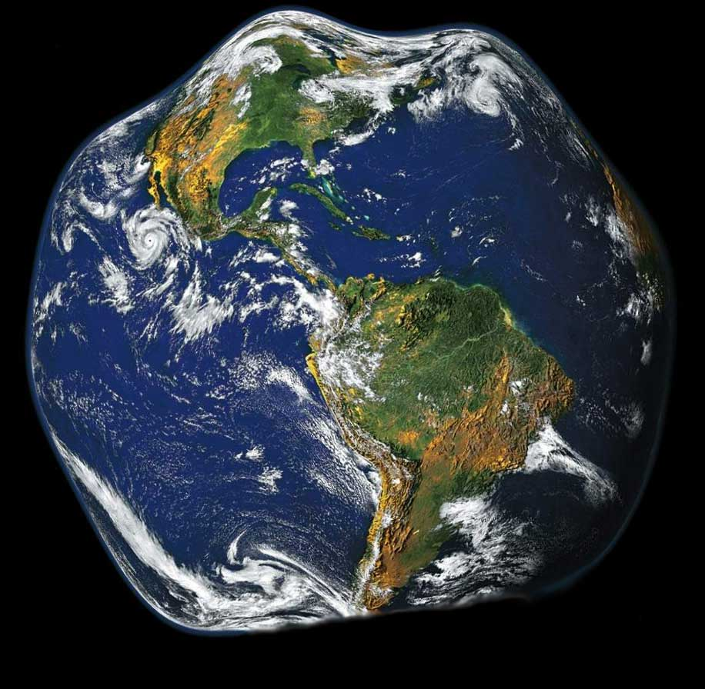
Global challenges
Human growth
20/80 dilemma
Climate
550/450/350 dilemma
Ecosystems
60 % loss dilemma
Surprise
99/1 dilemma
Notes:
Much pressure is imposed to our planet today. Much of this comes from the growing of human population.
Today, climate change is a further challenges which has impacted public policies all over the world. Ecosystem loss is other concern of governments, private sector and households. As the future is unknown, also other challenges might arise to humanity.
‹#›

Slide 22


Disaster and poverty
  Exposure to disasters do not depend on economic development
  Disaster consequences are much higher in developing countries
    Impact to GDP (relative weight)
    Number of people killed
    Damage to infrastructure
    Resilience
  The level of inequality is even greater because of under-reporting
Notes:
Similar flood disasters have occurred in Albania. In 2015, over a three-day period from 31 January to 2 February, around 350 mm of rain fell in south-eastern Albania, affecting 42,000 people and flooding 12,225 hectares of arable land. A Post Disaster Needs Assessment (PDNA, 2015) in May 2015 determined that the economic cost of damage to the agricultural sector alone was 31.5 million Euros.
‹#›

Slide 23
Disaster in numbers
  1900-2015
    More than $7 trillion damage
    8 million people died
  Damage in absolute terms (1997-2018)
    USA (US$ 945 billion from 482)
    China (US$ 492 billion from 577 )
  Geographic distribution
    Asia – highest number of disasters
    Africa – highest death rate in relation to population
  Type of disasters
    Floods
    Storms and hurricanes
    Earthquakes
    Tsunamis, Volcanoos
Notes:
Similar flood disasters have occurred in Albania. In 2015, over a three-day period from 31 January to 2 February, around 350 mm of rain fell in south-eastern Albania, affecting 42,000 people and flooding 12,225 hectares of arable land. A Post Disaster Needs Assessment (PDNA, 2015) in May 2015 determined that the economic cost of damage to the agricultural sector alone was 31.5 million Euros.
‹#›

Slide 24
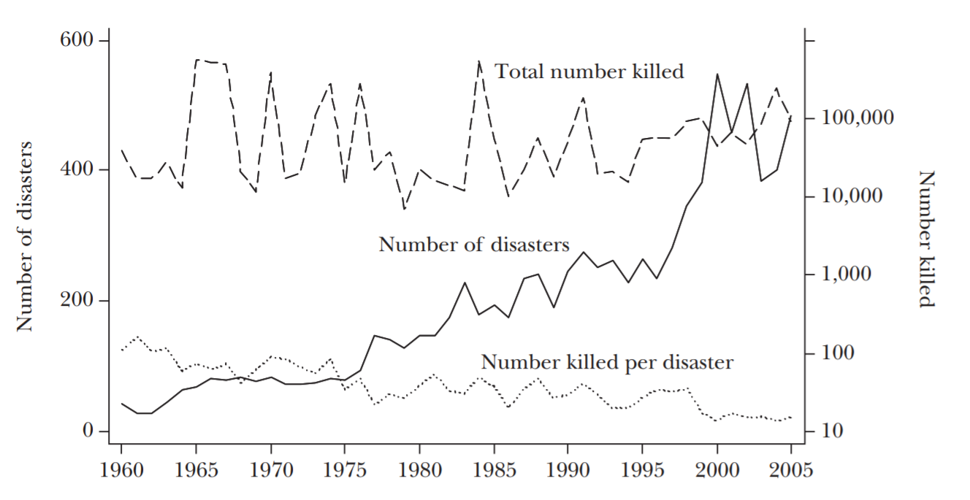
Disasters in numbers
Notes:
Similar flood disasters have occurred in Albania. In 2015, over a three-day period from 31 January to 2 February, around 350 mm of rain fell in south-eastern Albania, affecting 42,000 people and flooding 12,225 hectares of arable land. A Post Disaster Needs Assessment (PDNA, 2015) in May 2015 determined that the economic cost of damage to the agricultural sector alone was 31.5 million Euros.
‹#›

Slide 25
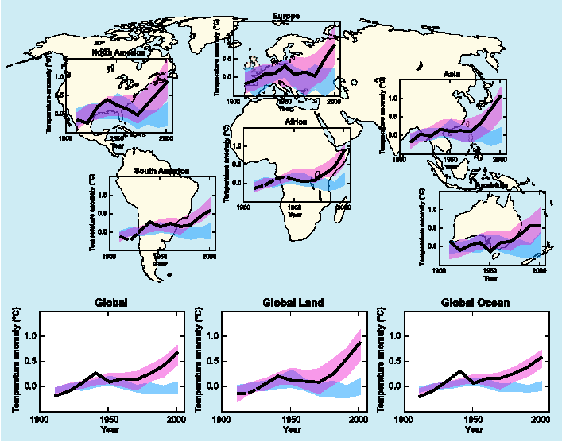
Evidence on climate change
Change from Natural factors
Change from Anthropogenic + Natural factors
(IPCC, 2007)

Slide 26
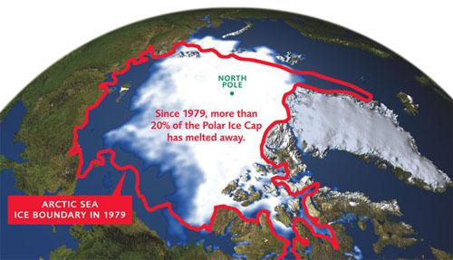
Evidence on climate change

Slide 27
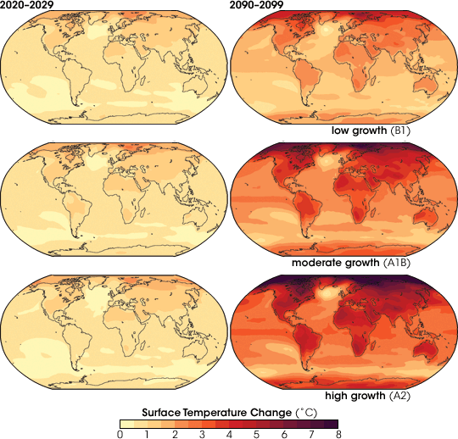
Projections of future changes in climate
Projected warming in 21st century expected to be
greatest over land and at most high northern latitudes
and least over the Southern ocean and parts of the North Atlantic Ocean

Slide 28
Climate change impacts
  Increase of weather disasters
  Public water supply and drinking water
  Biodiversity loss
  Agricultural production
  Forestry yield
  Energy for heating and cooling
  Tourism and recreation
  Health
Notes:
‹#›

Slide 29
Disasters and climate change
  Climate change affects disaster risk and development in two ways:
    short-term climate variability and its extremes
    longer-term variability
  Climate change action and disaster risk management practices not in the same agenda
  Climate change action
    Mitigation
    Adaptation
Notes:
Similar flood disasters have occurred in Albania. In 2015, over a three-day period from 31 January to 2 February, around 350 mm of rain fell in south-eastern Albania, affecting 42,000 people and flooding 12,225 hectares of arable land. A Post Disaster Needs Assessment (PDNA, 2015) in May 2015 determined that the economic cost of damage to the agricultural sector alone was 31.5 million Euros.
‹#›

Slide 30
|Second Part
Disasters and macroeconomic risk

Slide 31
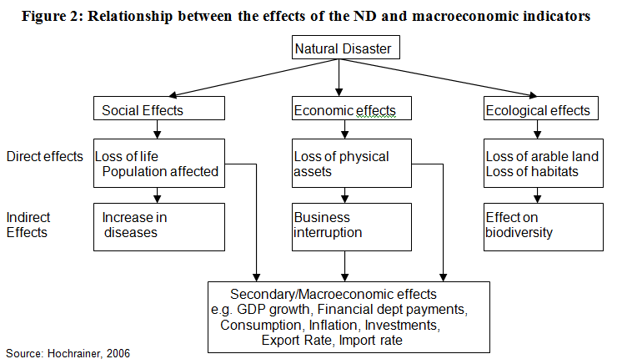
Macroeconomic risk of natural disasters
Notes:
Economic impacts of a natural disaster are usually grouped into three categories: direct, indirect, and macroeconomic effects (often called also secondary effects). Direct economic damages are mostly the immediate damages due to the event per se. The direct stock damages have indirect impacts on the “flow” of goods and services, i.e. indirect economic losses occur as a consequence of physical destruction affecting households and firms. Most important indirect economic impacts include: diminished production/service due to interruption of economic activity; increased prices due to interruption of economic activity leading to reduction of household income; increased costs as a consequence of destroying roads, e.g. due to detours for distributing goods or going to work; loss or reduction of wages due to business interruption. It should be kept in mind that the social and environmental consequences also have economic repercussions. The reverse is also true since loss of business and livelihoods can affect human health and well-being.
The public sector has in most of the cases the responsibility to bear the cost of damages caused by a disaster. Therefore macroeconomic impacts also arise in case of disasters. The disaster will affect different sectors in varying degrees and thus will be reflected in the macroeconomic performance of the country’s economy. Table 1 illustrates some potential impacts of a disaster event.
‹#›

Slide 32
Macroeconomic Indicator | Expected change
GDP | Immediately drop in GDP growth in the year of the event Rise in GDP growth in the year after the event Slowdown in second and/or third year
Agricultural sector | Significant fall in production
Manufacture Sector | Decrease in activity due to disruption of transportation, reduced production capacities
Service Sector | Decrease in activity due to disruption of transportation and payment system
Exports of goods | Reduction in the rate of growth in the year of the event In the year after return to the previous levels In subsequent years continuation of the year after
Imports of Goods | Considerable increase in the rate of growth in the event year A return to pre-disaster level a year after In subsequent years a further drop, possibly caused by reducing incomes
Gross Formation of Fixed Capital | Sharp increase in the year following the disaster
Inflation rate | Short increase caused by the disruption of production and distribution and increasing transportation costs
Public financing | Worsening of deficit due to a shortfall in tax revenues and increase of public expenditures
Trade balance | Deficit due to decrease in exports and an increase in imports, associated with the decline in production capacities and strong public and private investments for reconstruction
Notes:
Several macroeconomic indicators are effected by a disaster event. These include, GDP…..
For GDP impact, is understandable that in the year of the event a immediate drop will be caused. The aftermath often is affected by the ability of public sector to respond to the disaster event, through its reconstruction policies. Sometimes the GDP level in the longrun might overcome the GDP level before the disaster event following these strong public policies.
‹#›

Slide 33
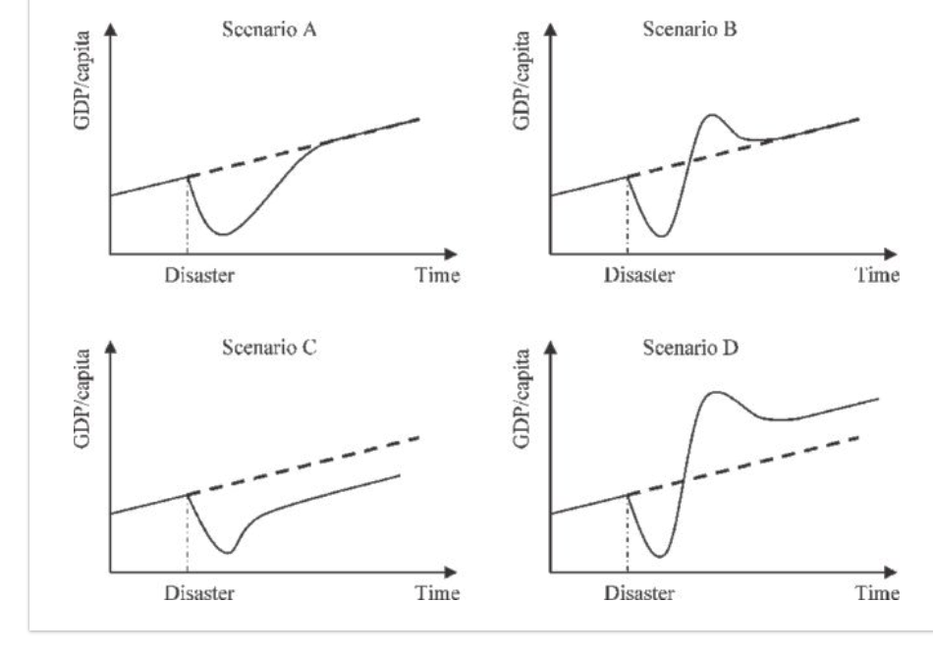
GDP Scenarios in case of disasters

Slide 34
|Third Part
Disasters and risk perception

Slide 35
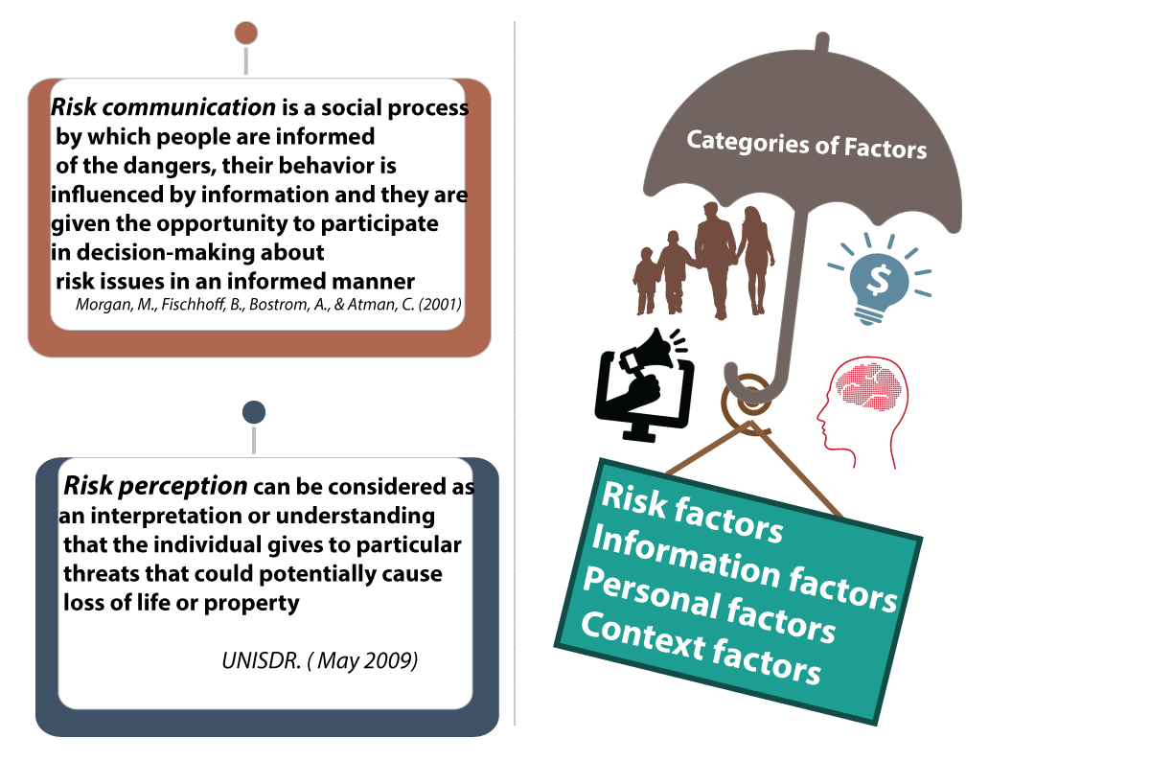
Overview

Slide 36
Risk perception and factors related to it
Risk factors
  Related to experience with past disaster events
Information factors
  Related to public trust and risk communication
Personal factors
  Related to demographic factors in line with risk theory
Context factors
  Related to household and income conditions

Slide 37
Risk communication
Any population exposed to natural dangers wish and should be optimally informed about the risk characteristics, preventive measures and appropriate behaviors during emergencies.
Authorities should devise appropriate planning, prepare coping strategies, and effectively communicate information to residents, people in the workplace, and communities as a whole.
Better response to natural disasters requires active involvement of residents, which should have been informed and taught about the dangers they are facing
Public discussion, stakeholder participation and perhaps joint resolution of conflicts are needed
Risk communication is perceived as a necessary link between perception of risk and its management.
Communication programs should be based on a sound understanding of individuals' sociopsychology

Slide 38

Thank you

